Slide 1


Experience API

Slide 2
Experience API
Track data of learning experiences, broadly defined
Notes:
xAPI stands for Experience Application Programming Interface.
X is for Experience, because xAPI allows detailed tracking of “learning experience” data.

Slide 3




Notes:
…weather that experience looks like this… or this… or this… or this.

Slide 4
Experience API
Track data of learning experiences, broadly defined
Enable machine-readable communication (interoperability), storage, and access of the data
Notes:
API stands for Application Programming Interface.
“API” is a commonly used software term that refers to the programming definitions, rules, and protocols that allow systems to “talk” to each other.

Slide 5



<MESSAGE>
<RESPONSE>
Notes:
APIs allow:
Data Access – Allowing access to data through protocols, not add-ons.
Data Readability – Common definition of data, otherwise would be reliant on the database schema.
Data Portability – Data can be exported to other systems, even if they aren’t like each other(LMS > HR systems)

Slide 6
(AKA Tin Can)
Experience API
version 1.0.3
Enable machine-readable communication (interoperability), storage, and access of the data
Notes:
Ok, but what *is* xAPI???

Slide 7

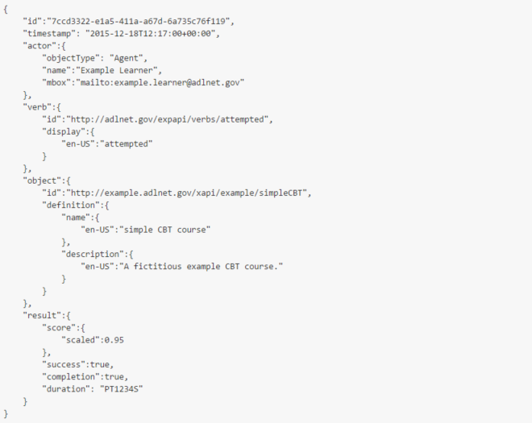
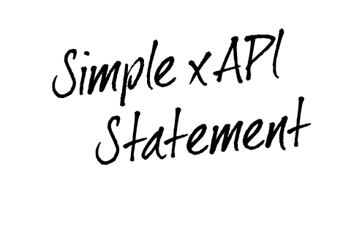




Notes:
xAPI is a technical specification for defining data, as well as set of reference implementation models for its uses (that is, usage guidelines such as the different xAPI “profiles”) and nested specifications for its storage, authentication, and access (i.e., the Learning Record Store). xAPI uses the RESTful web-services architecture and four specific web-service APIs. xAPI is agnostic about the type of learning content being delivered, and allows flexible tracking of learning activities and experiences, including formal e-learning courses, performance-based tracking, group-based or social learning, and even informal learning scenarios.

Slide 8
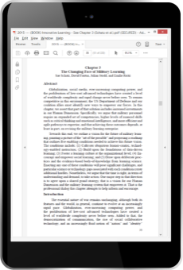


<xAPI>
<xAPI>
<xAPI>
Notes:
xAPI can be incorporated into any new or existing learning technology. Once integrated, that system can track and share learner data.

Slide 9



Slide 10
4 Volunteers?
DIRECTIONS:
Judge these pictures as completely and accurately as possible

Slide 11





Slide 12
What did you name each one?
How do I know who made the scores?
How did you record the scores/ratings?
What would we have to do, if we wanted to analyze all your results?

Slide 13
What if we gave you each a standard way to name them and suggested which criteria to rate?

Slide 14
DIRECTIONS²:
Judge these pictures as completely and accurately as possible
Name yourself with a unique identifier (UID)
Consider these common criteria
{ Display Quality, Artistic Value, and Color Theory }
Name each by it’s official UID, too
{ The Kiss, Starry Starry Night, Mona Lisa, Grumpy Cat }
Score all of the criteria from 1-10

Slide 15
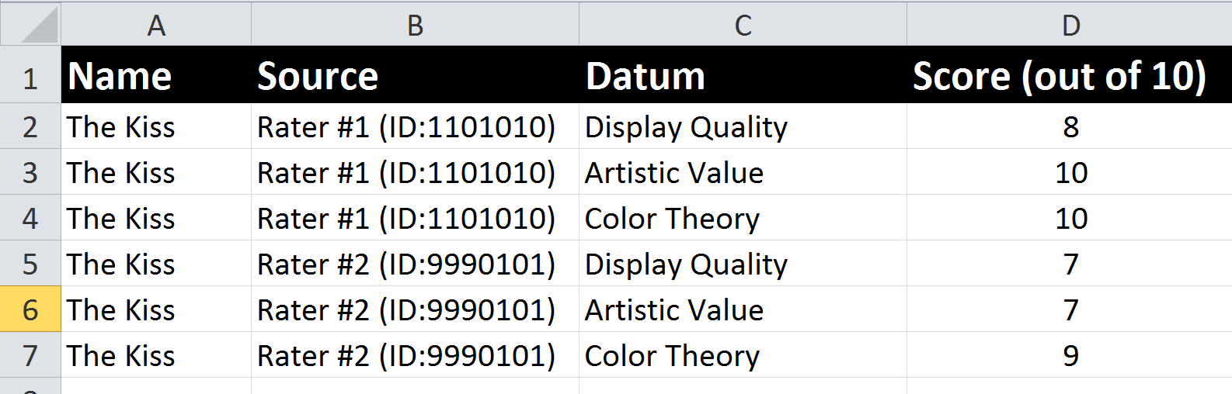
Now… we might be able to create something like this:

Slide 16
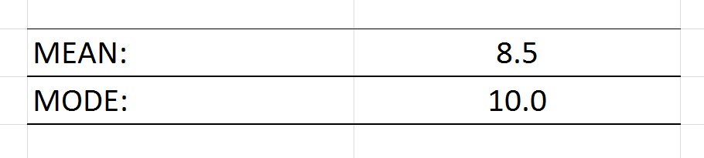
…And we could do analysis across different raters, different images, etc.

Slide 17

This is Syntactic Interoperability
It’s like all of us agreeing to use the same spreadsheet format, so we can share data.
Syntactic
Interoperability

Slide 18
But do we mean, when we say “Artistic Value”?
…or when we say “8 out of 10”?

Slide 19

DIRECTIONS³:
Judge these pictures as completely and accurately as possible…
Rater Name
Common Criteria
Picture Name
Score
…and use these definitions:
Artistic Value is a measure of the artwork’s impact culturally…
A score of 10 out of 10, means…

Slide 20



We do this for both people and computers…
Notes:
rubric | by lewisr1

Slide 21
This is Symantec Interoperability
It’s like all of us agreeing to the same meaning for words, ratings, and so on.
Symantec
Interoperability

Slide 22
xAPI lets you capture (big) data on human performance that is syntactically and semantically interoperable
Syntactic
Interoperability
Symantec
Interoperability

Slide 23




Slide 24






Notes:
Syntactic and semantic interoperability of (learning experience) data is important for several reasons, depending upon your perspective.
For learning scientists, this allows greater insight into learners’ performance longitudinal and opens-up the possibility of cross-platform / long-term personalization of learning.
For computer scientists and data mining, this allows for mass aggregation of data, which can be used to analyze the system, for instance, which learning pathways lead to greatest success? Which instructors appear to produce the most qualified students? Which simulation-based training opportunities have the greatest impact on downstream performance?
For human resources professionals (J1s), this allows greater insight into individual and collective human capital management, to potentially help inform selection, professional development opportunities, or readiness estimates.

Slide 25


(the basics)

Slide 26

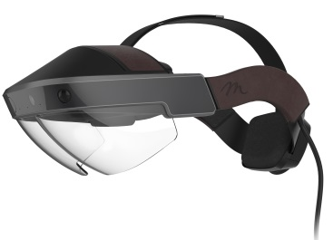

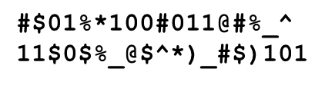
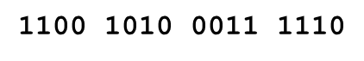
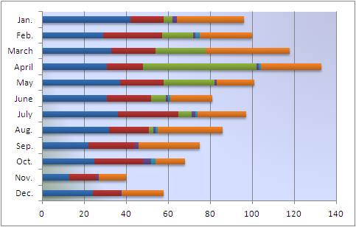
xAPI
Profile
Learning Mgmt System (LMS)
LRS²
Learning Record Provider
Learning Record Store (LRS)
LRS³
Learning Record Consumer
LRS⁴
xAPI Statement
Notes:
Learning Record Store – Basically the xAPI database
Learning Record Provider – Provides data (it could be anything, i.e., a web-based course, a simulation, any input system)
Learning Record Consumer – Consumes data

Slide 27
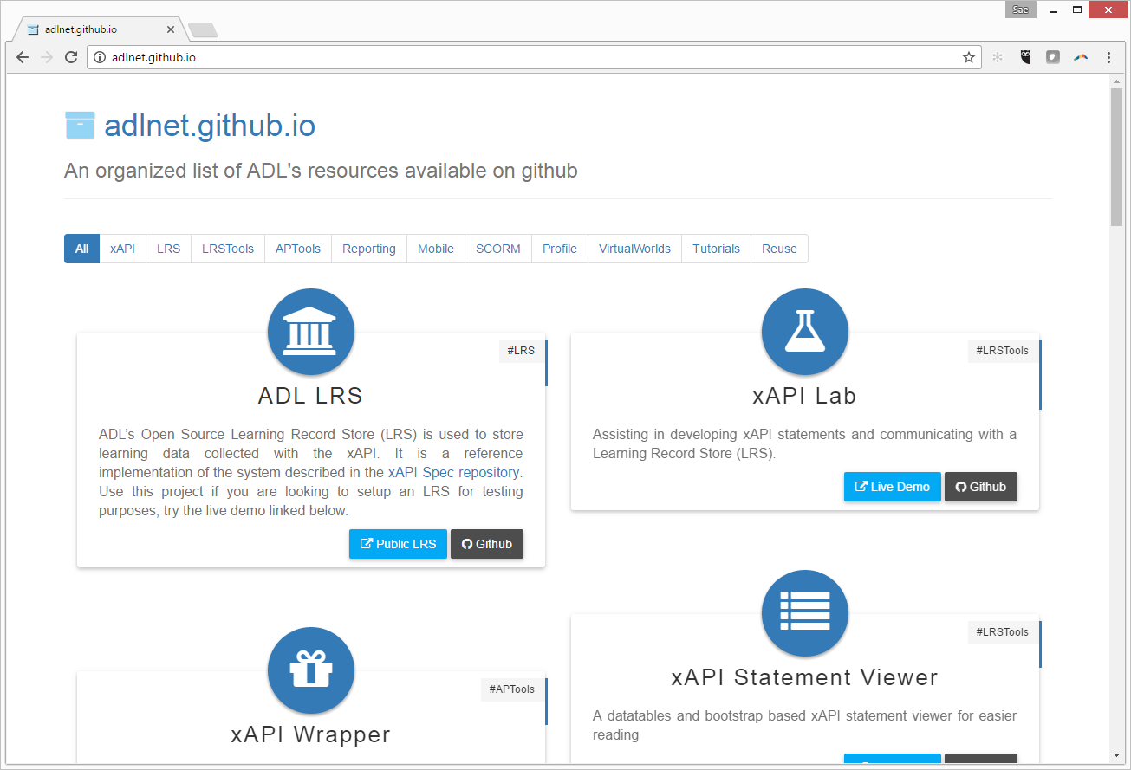
ADL Usage Guides (e.g., profiles, snippets) @ http://adlnet.github.io

Slide 28
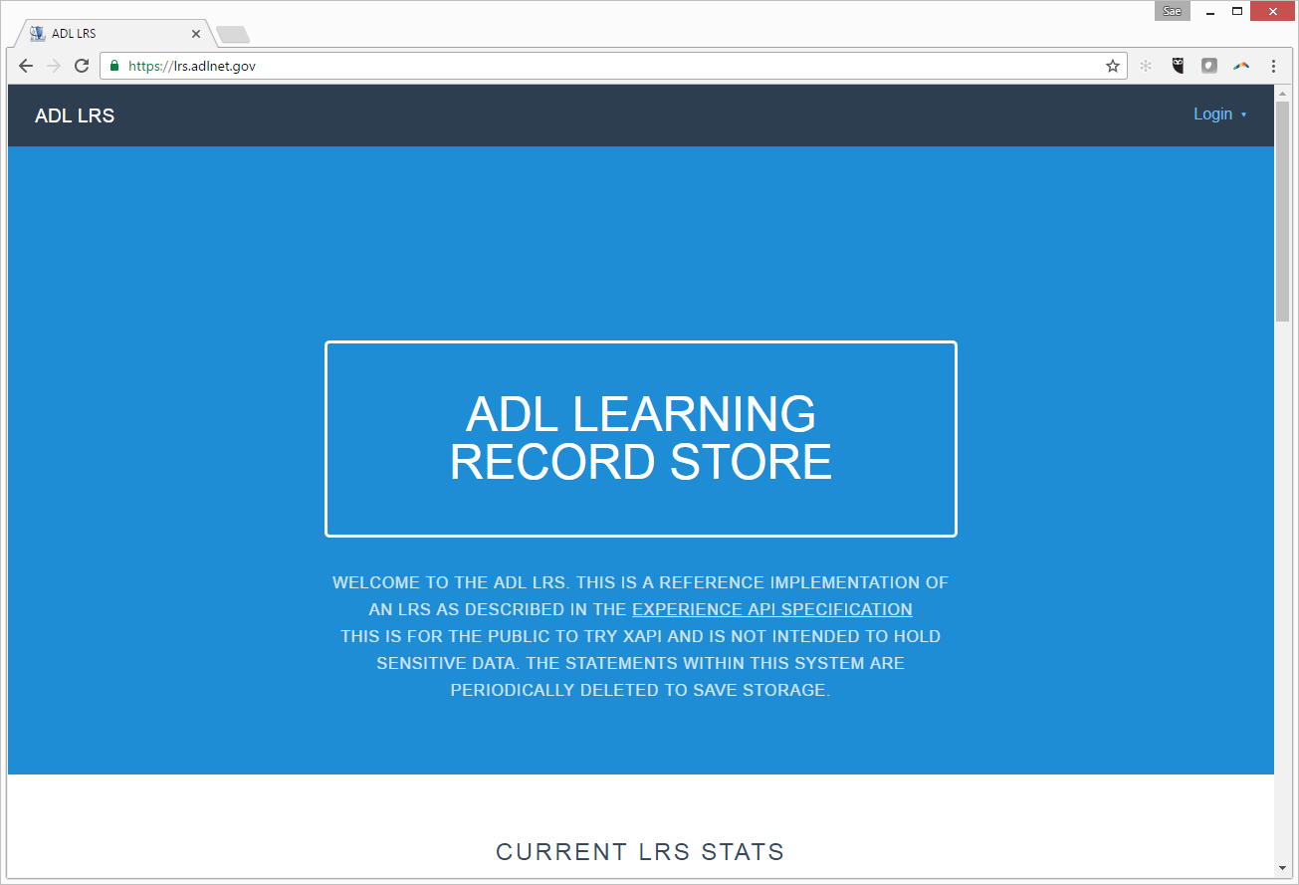
Hosted ADL LRS @ https://lrs.adlnet.gov

Slide 29
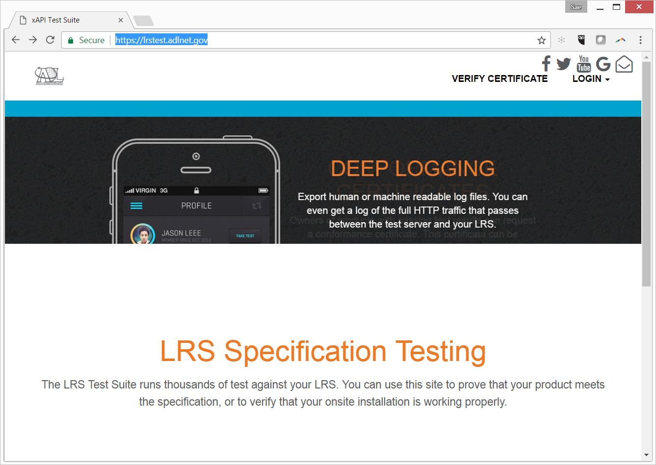
Fungible References @ https://lrstest.adlnet.gov

Slide 30
https://lrs.adlnet.gov
http://adlnet.github.io
https://lrstest.adlnet.gov

Slide 31
Usage
Examples

Slide 32

Notes:
Range Experience Acquisition Portal for Evaluation and Reporting (REAPER)
During basic training in the Army servicemen and servicewomen must pass the basic rifleman marksmanship (BRM) range test. The purpose of this study was to investigate technology that could be used to track accuracy and performance in live firing range exercises. Both student progress and physical performance at the firing range was captured using the Experience API.
The live range was modified to collect training results data and then the data was associated to individual soldiers via their Common Access Card (CAC). The process begins with the shooter entering their PIN code into the student station and completing the training. While the training is occurring, xAPI statements are transmitted to the firing range LRS. The firing range LRS transmits its data to the a reporting LRS, where the data is aggregated to develop the corrective or remedial Interactive Multimedia Instruction.
The shooter, coach/commander, and researcher are able to log in to their respective portals to view the results. A dashboard was also developed to provide an analytical view into the results of the data as well as provide immediate remedial training material to the soldier to assist in improving marksmanship defects. For example, if the trigger is not properly squeezed, the rifle will be misaligned with the target at the moment of firing. So the IMI training provides immediate remediation based on the trigger performance data captured via xAPI.
The training value and benefits of this type of technology solution are far reaching, and applications include: target heatmaps for range operations information; human performance information for students coaches and researchers; analysis of the efficacy of training methods; automated tutoring; and many more.
For more information, see “Putting Live Firing Range Data to Work Using the xAPI,” by Paula J. Durlach et al., published in the Proceeding of the 2015 I/ITSEC Conference.

Slide 33

REAPER
REAPER
Notes:
Range Experience Acquisition Portal for Evaluation & Reporting
Live Training Range reporting results via xAPI/LRS
Experience Application Programming Interface (xAPI)
Learning Record Store (LRS)
Corrective IMI delivered to Shooter
Interactive Multimedia Instruction (IMI)
BRM10 data automated to DTMS
Digital Training Management System
Basic Rifle Marksmanship (BRM)
Range data made available to Training Community
IMI training data made available
Different data views (audiences): Shooter, Coach/Commander, Researcher

Slide 34
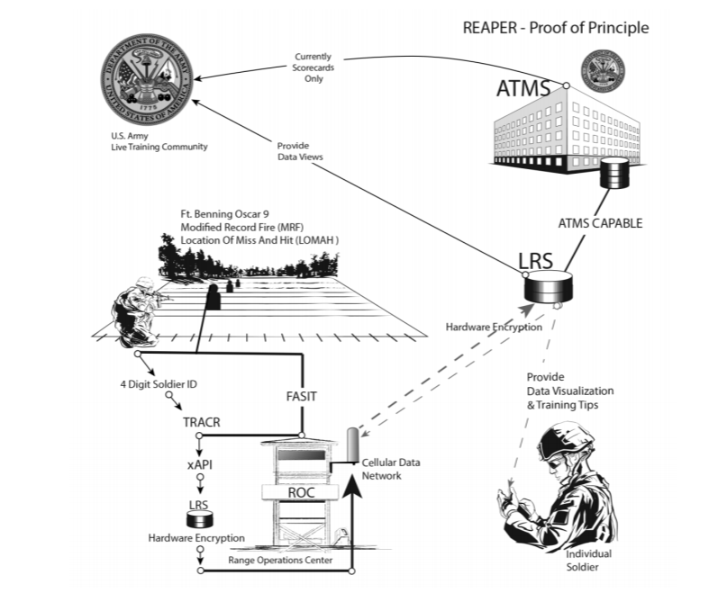
REAPER

Slide 35
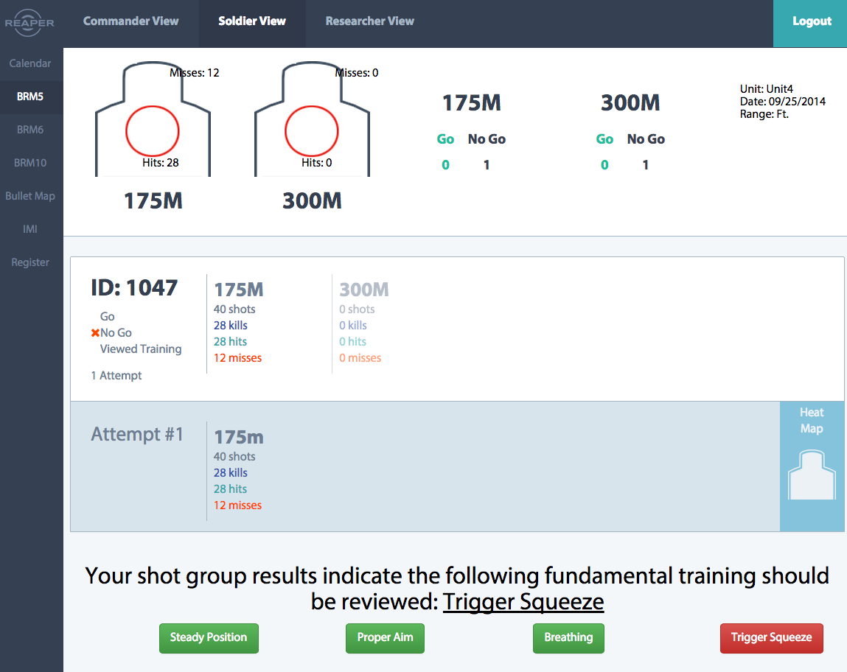
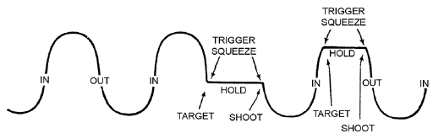
REAPER

Slide 36
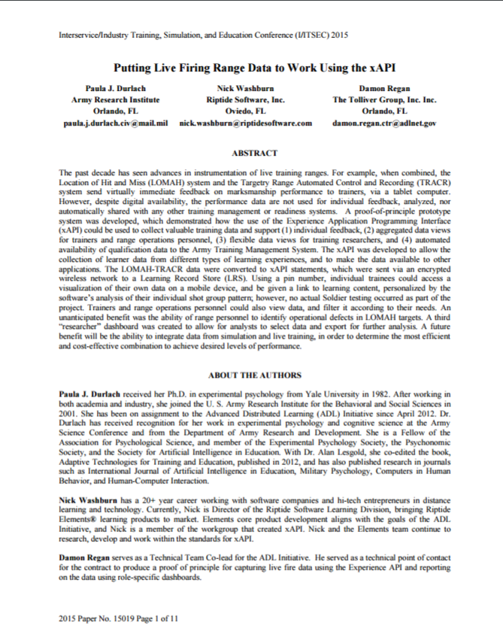
2015
I/ITSEC Paper

Slide 37

Notes:
The National Institute of Standards and Technology (NIST) and US Ignite partnered with the Department of Transportation (DoT), National Science Foundation (NSF), International Trade Administration (ITA), Department of Health and Human Services (HHS) and Department of Energy (DoE) to create the Global City Teams Challenge to advance practical applications of the latest research in cyber physical systems. The Global City Teams Challenge is an initiative of NIST and U.S. Ignite to advance the deployment of Internet of Things technologies within smart city and smart community environments.
Fairfax Fire and Rescue, Inova Hospital, George Mason University, and ADL led the initial simulation design. This was the first time xAPI was being used in conjunction with Internet of Things (or internet connected) technologies in the field to collect data from an emergency training simulation.
The EMTs were wearing beacons, the Android phones were attached to the ambulance, and positioned at the doors of the emergency room. The simulation mannequin sent proximity data between patient and rescuer to an xAPI learning record store (LRS) where the data was visualized in real time and made accessible to the team of nurses and doctors at the hospital, all of whom are also wearing beacons and whose preparations are recorded live to the same LRS.
This case study illustrates the ability to provide a complete view into complex multi-team training operations. xAPI was used for reporting data from wearables and medical device equipment. This live simulation training scenario would to also translate into improved outcomes for patients.

Slide 38

Case Studies – Global City Challenge
Notes:
Throughout the call
Data captured by phone apps, bridged to xAPI, transmitted to Yet Analytics LRS
Rate of ~ 1 statement per second per beacon
20 beacons for personnel proximity to Sim Man
2 beacons for Sim Man proximity to vehicles and trauma bay
Specific medical and team response data captured manually through xAPI and Xapier (redundancy) iPad apps
Simulation ran for 60 minutes
Proximity statements continuously collected
Discrete medical events (hear rate, blood pressure, or other) events collected

Slide 39

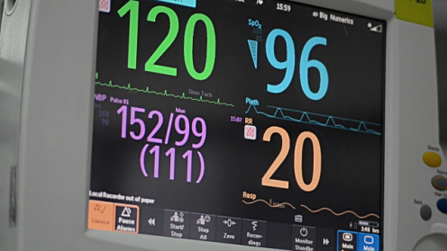

Case Studies – Global City Challenge
LRS
39
Notes:
Emergency Medical Training Simulation

Slide 40
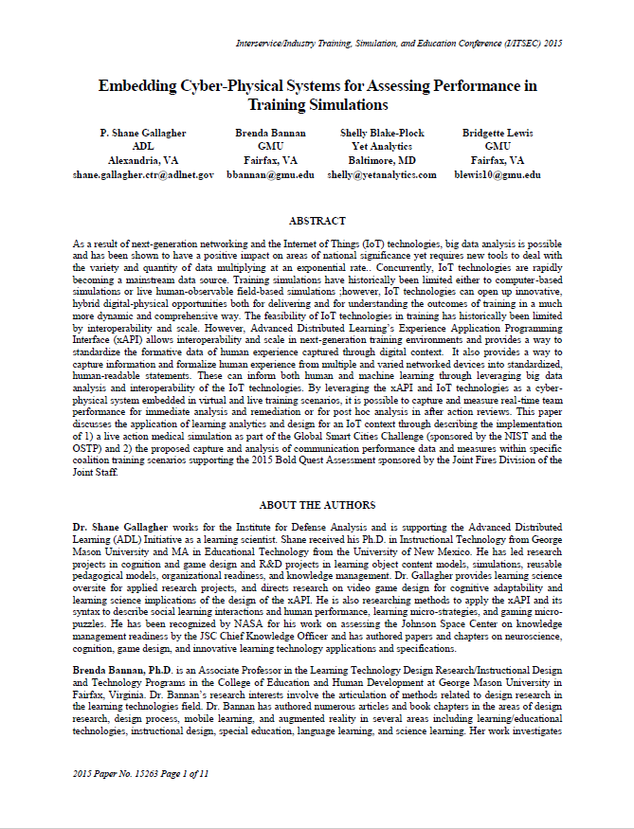
2015
I/ITSEC Paper

Slide 41

Notes:
I would like to start off explaining this case study by defining an acronym I’ll be using. An “RTO” is a regional transmission organization in the United States. It’s an electric power transmission system operator which coordinates, controls and monitors a multi-state electric grid. This case study focuses on a scenario where an RTO had large training manuals that were handed out on USB drives to students.
The RTO delivered large workshops covering in-depth technical materials and procedures through documents that allowed students to make notes, edits and annotations as they work through training material. Unfortunately, the documents were controlled intellectual properties and cannot be released in electronic hard copy to attendees. It was also difficult for the RTO to understand how students are using the support materials in and outside of class. There were security concerns with uncontrolled distribution of valuable documents. In addition, the customer’s IT group considered the USB drives to be a potential virus source.
With the USB drives, students could annotate documents and take the annotations with them at the conclusion of the class. However, when the documents are stored locally, there is no central way to update them and keep them up-to-date. If documents were not to be distributed, how could this valuable function be replicated?
Tablet computers were considered and rejected. The students were not employees of the customer, so distributing iPads to all students was cost prohibitive. It was valuable to be able to track which annotations were made. Knowing what pages received the most annotations, as well as the most common annotations would allow the customer to improve their documents.
This case study used a combination of a learning management system (LMS), a learning resource store (LRS), and the Experience API (xAPI) to enables learners to access these annotated documents via their LMS. They also developed a dashboard to display paradata (or usage data). This type of data is useful for seeing which documents were accessed and the type of interactions that occurred within them for more in-depth correlations to training. The PDF Annotator application tracks the initialization of content and captures notes, annotations, reviews and updates to materials in the LRS. Since the annotations and notes are stored in the cloud via xAPI, the student can move from device to device and still maintain visibility of their notes without storing an uncontrolled copy of the materials.
http://risc-inc.com/pdf-annotation-cloud-real-world-xapi-application/

Slide 42
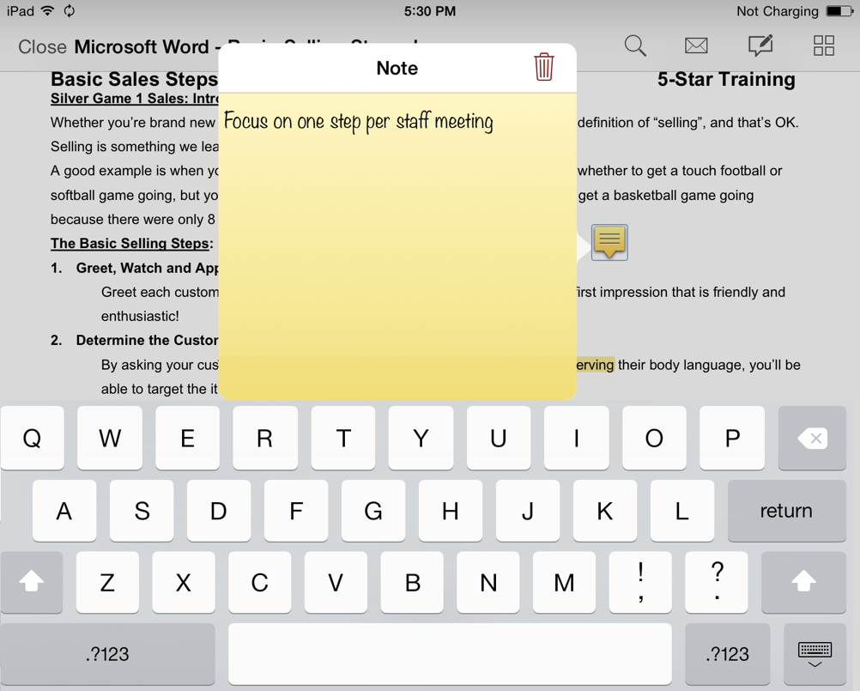
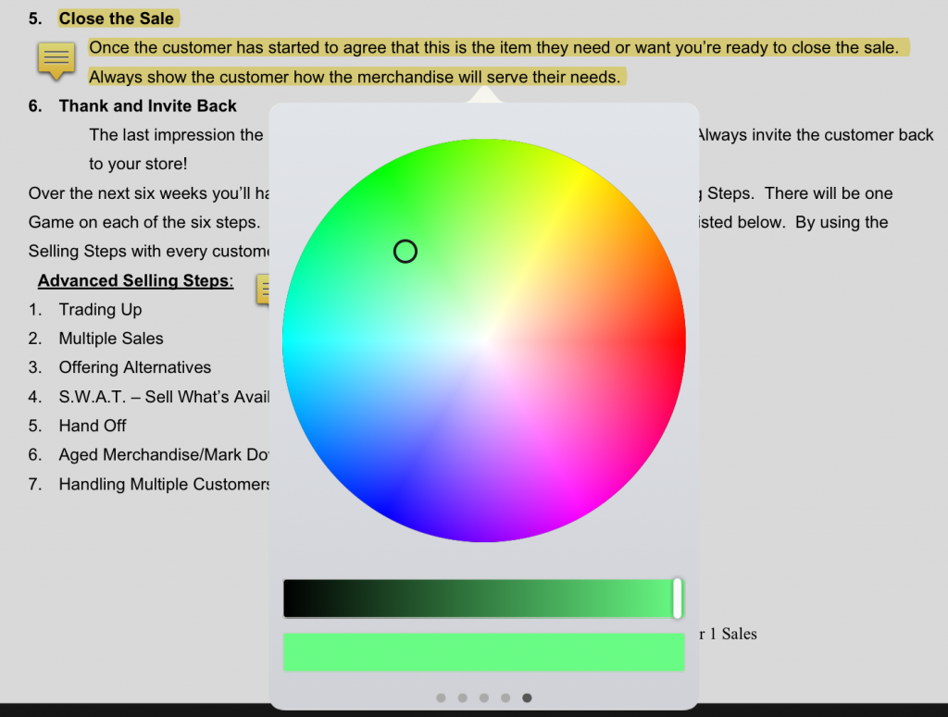
Case Studies – RTO PDF Docs
Images courtesy of http://risc-inc.com
Notes:
They had large PDF training manuals that were delivered to training attendees on memory sticks. They had a need for their students to be able to annotate these PDF documents with notes from the training. The customer also had a goal of being able to track the annotations made in order to help them to improve the underlying documents, but didn’t really have any expectation of meeting that goal in reality.

Slide 43
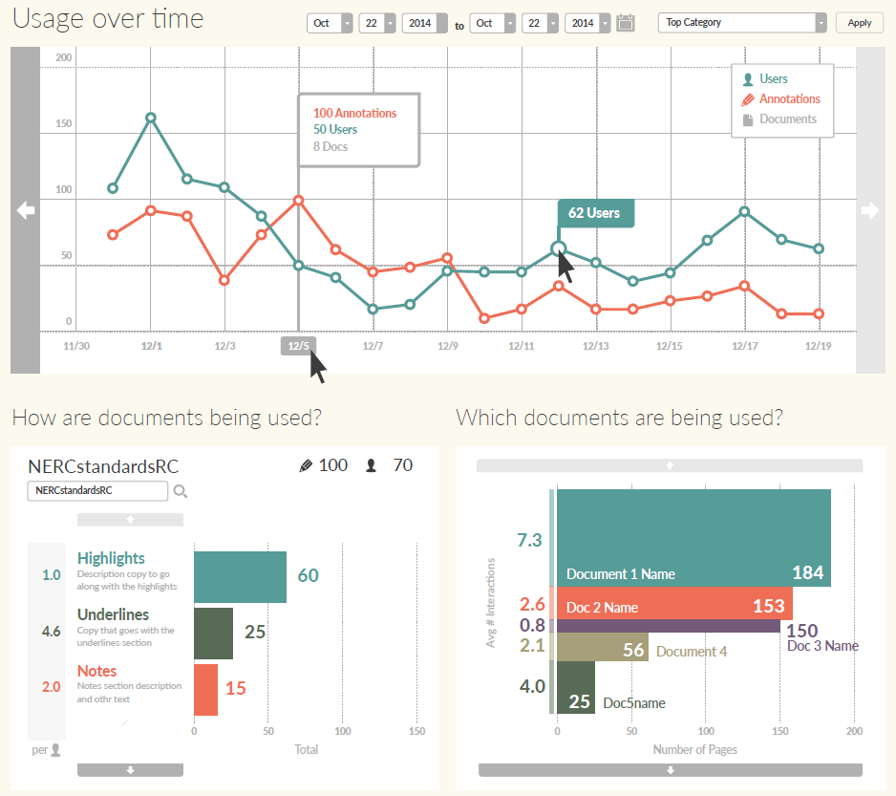
Notes:
Paradata collected using xAPI in PDF annotator

Slide 44

Notes:
RADIO FREQUENCY EDUCATION (RFED) HANDS-ON MUSEUM & EXHIBITS
The Hands-On Museum case study takes place at a children’s STEaM (science, technology, engineering, art, math) museum based in Ann Arbor, Michigan. Museum educators were eager to offer an enhanced field trip experience for school children, one that would show quantitative data related to the learning experience and the science standards that schools and teachers are held to. The resulting data helps teachers tie their museum field trip visits to curriculum standards to ensure that their time (and their budget) is spent meaningfully.
The Museum wanted to accomplish two goals: 1) encourage school field trips by providing teachers with quantitative data and 2) provide a richer experience for children by slowing them down long enough to interact meaningfully with the exhibit and learn something more. To accomplish both goals, the museum would need to track which students were at which exhibits and what they did there.
This case study combined RFID technology, tablets, and xAPI to meet all these needs. RDID stands for Radio-frequency identification (RFID) and uses electromagnetic fields to automatically identify and track tags attached to objects. In the first iteration, the museum used RFID tags embedded into nametag lanyards to passively log students into each exhibit. As the children came within range of a wall-mounted antenna, a tablet computer mounted nearby greeted them by name and engaged them in a short series of questions and explorations with the exhibit.
Data from each student activity is sent back to the LRS (Learning Record Store) immediately after the student(s) complete the interaction, or after they “log out” by leaving the area (as determined by the antenna). Teachers and museum staff later accessed a dashboard showing an activity stream and some simple data visualizations by student and by exhibit.
When each student—or group of students—approached the exhibit, the antenna picks up on their name badges and the tablet opens up the appropriate grade level content. One of the advantages of the xAPI over SCORM is that it can record the same activity data for multiple learners at once. Each time a question is answered or a response given on the tablet, an xAPI statement is formed.

Slide 45
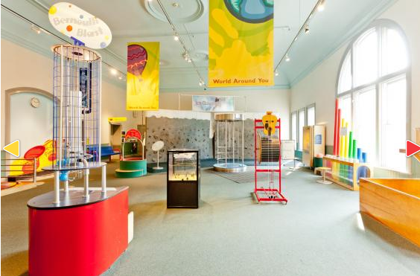
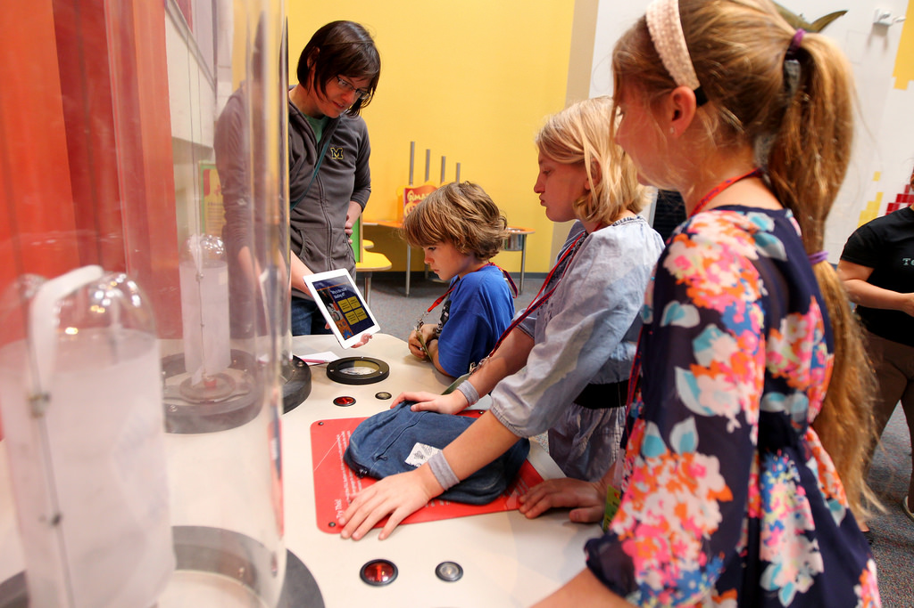


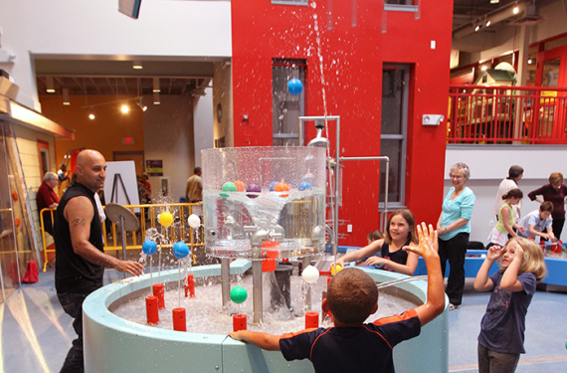
Notes:
Images from https://www.theclio.com/web/entry?id=25428 CC:Attribution
Photos by Jamie Wasilchenko
Ann Arbor Hands On Museum:
Extends after the school field trip using RFID cards inserted into lanyards for each student
Refreshable content so the experience is new and different with each visit
Sustainable in terms of revenue so that the Museum can continue to offer this enhanced experience

Slide 46
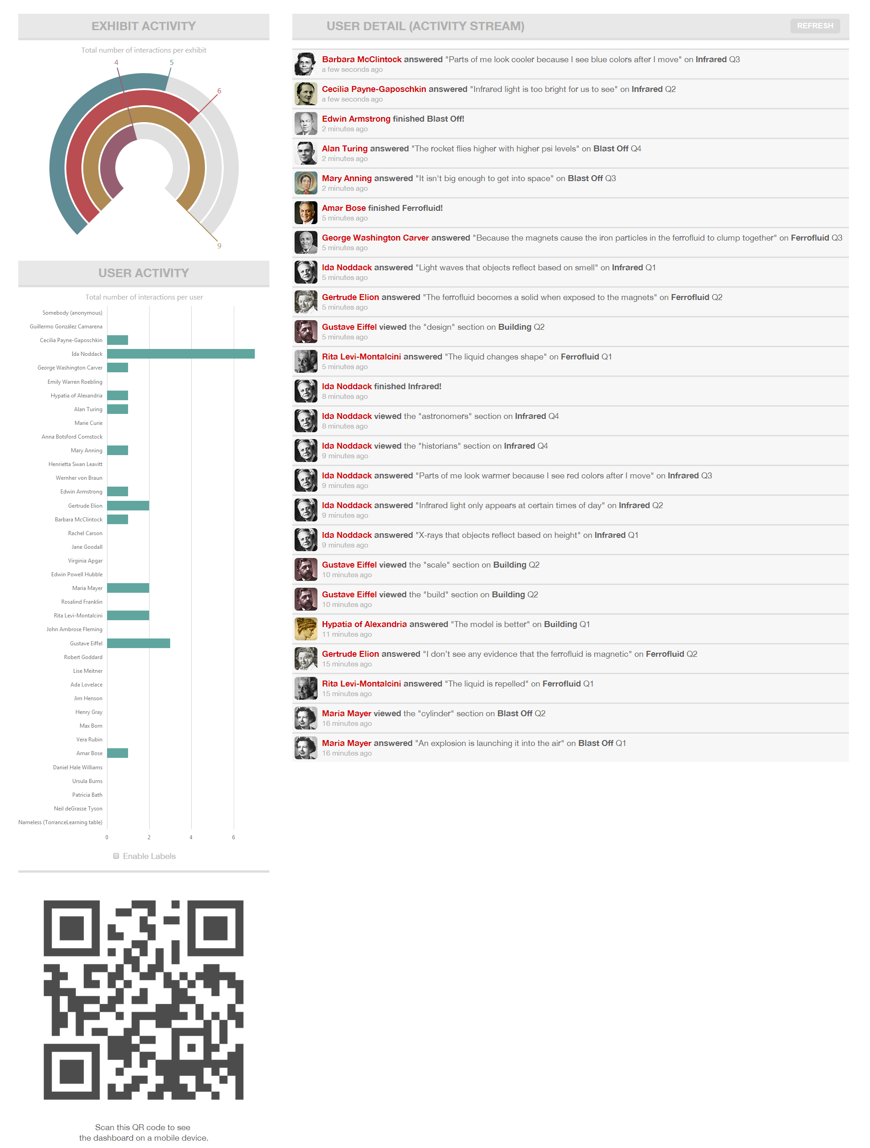
Notes:
They built an xAPI dashboard. It shows BOTH sets of code live on the same screen tap – make a choice on the screen and the result is captured by the the xAPI LRS..

Slide 47
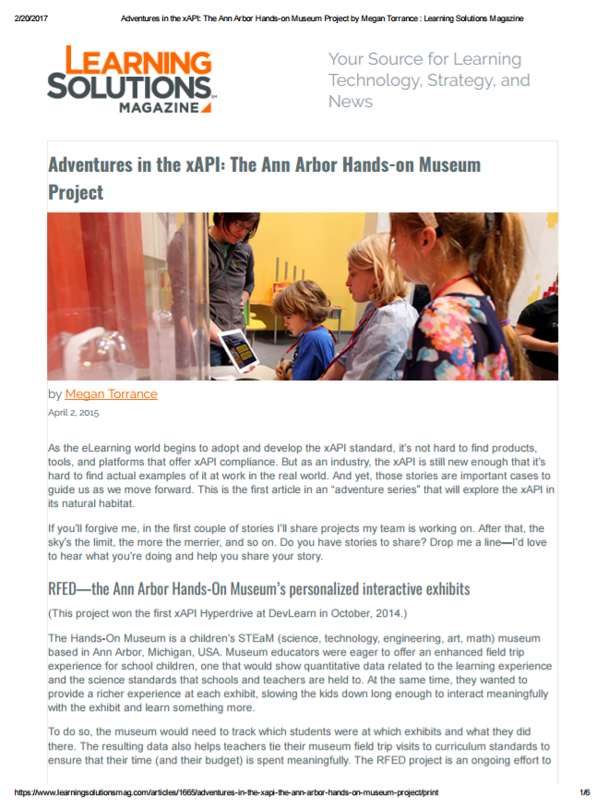
2015 Learning Solutions Magazine
Notes:
https://www.learningsolutionsmag.com/articles/1665/adventures-in-the-xapi-the-ann-arbor-hands-on-museum-project/print

Slide 48
Future Learning Ecosystem
(TLA)
Notes:
A brief glimpse at the Total Learning Architecture.
The Total Learning Architecture is a collection of specifications for accessing and making use of learning-related data.

Slide 49




e-book
LMS
Mobile
VR Simulation

Slide 50
e-book
LMS
Mobile
VR Simulation

Slide 51




Slide 52


Slide 53
xAPI
Meta-Adaptation
Content
Learner
Pedagogy
Context
Competencies

Slide 54



Slide 55






Computer-Based Learning
e-Learning
Simulations
Intelligent Tutor
e-Book
m-Learning
APRIL 2017
Tutor
Activity Recommender
Activity Registry
Learning Record Store
Competency Framework
Competency Assertion
Notes:
“Real” simple architecture diagram

Slide 56
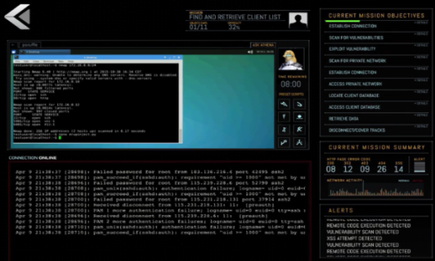
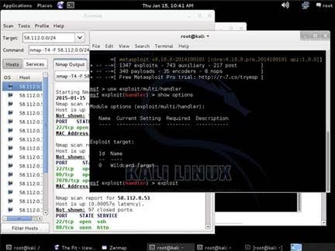
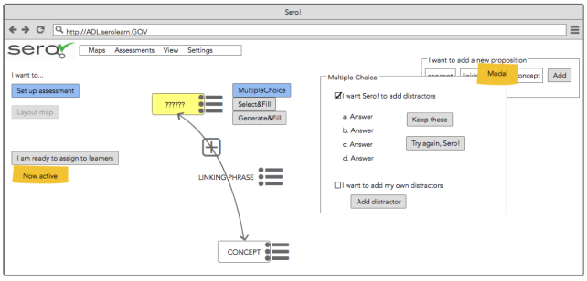
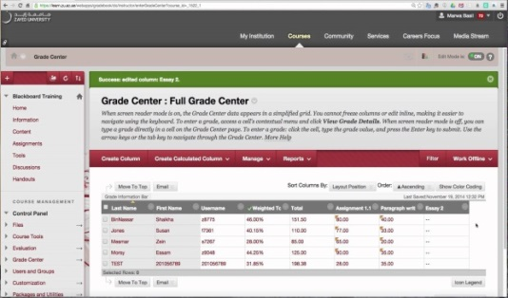

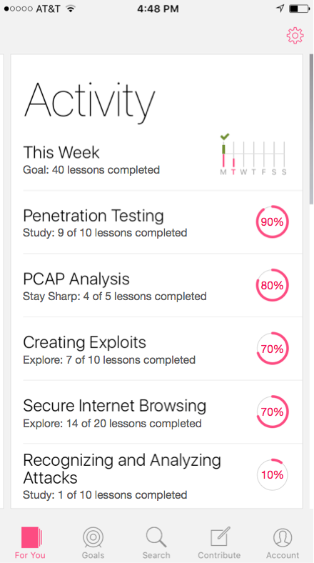
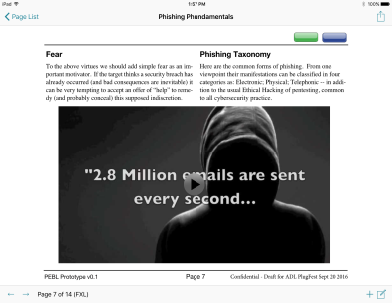
ARES
Serious Game
Cyber-Scorpion Simulation
Sero!
Concept Maps
Moodle
Courseware
GIFT
Intelligent Tutor
PERLS
Micro-learning
Actionable Databook

Slide 57




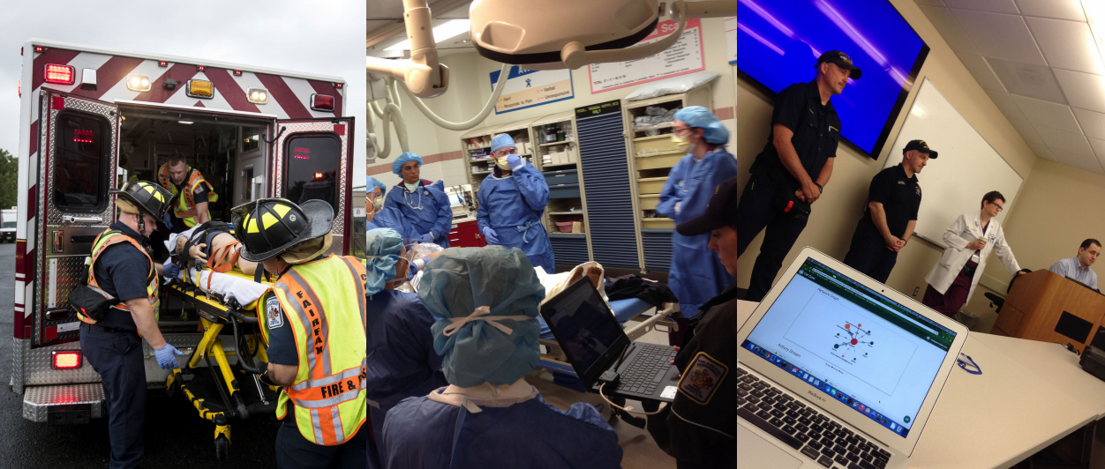

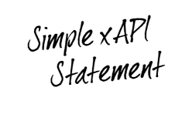




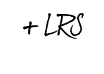

xAPI Concept
xAPI Overview
xAPI Examples

Slide 58
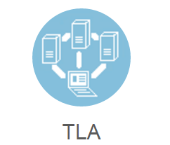

xAPI Concept
xAPI Overview
xAPI Examples
Future Vision

